Slide 1
8-dars(Model Building)
Davronbek Malikov

Slide 2

Bugun
Takrorlash
Cross validation
K-Fold
Amaliy
Regression
Classification
Vazifa

Slide 3
Takrorlash

Slide 4
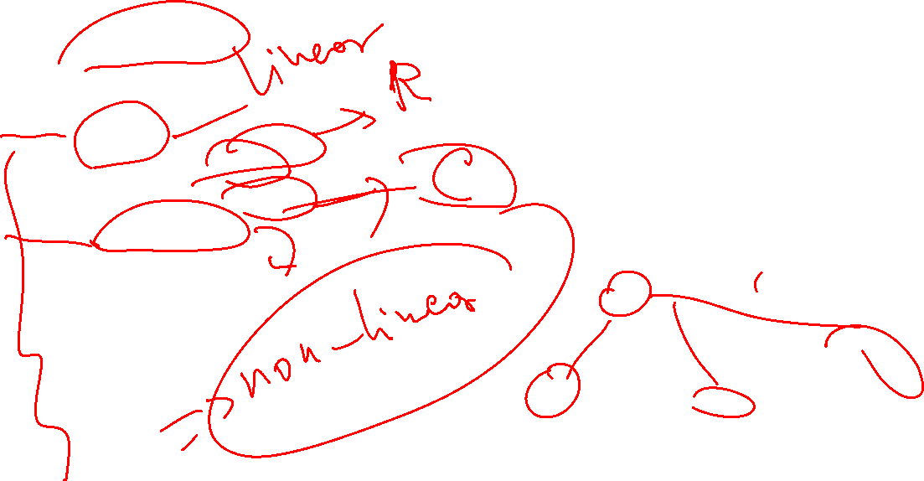
Takrorlash
Imtixon taxlili
Algorithms
Linear
Linear Regression
Logistic Regression
Tree – Based
Decision Tree
Random Forest

Slide 5

K-cross validation

Slide 6
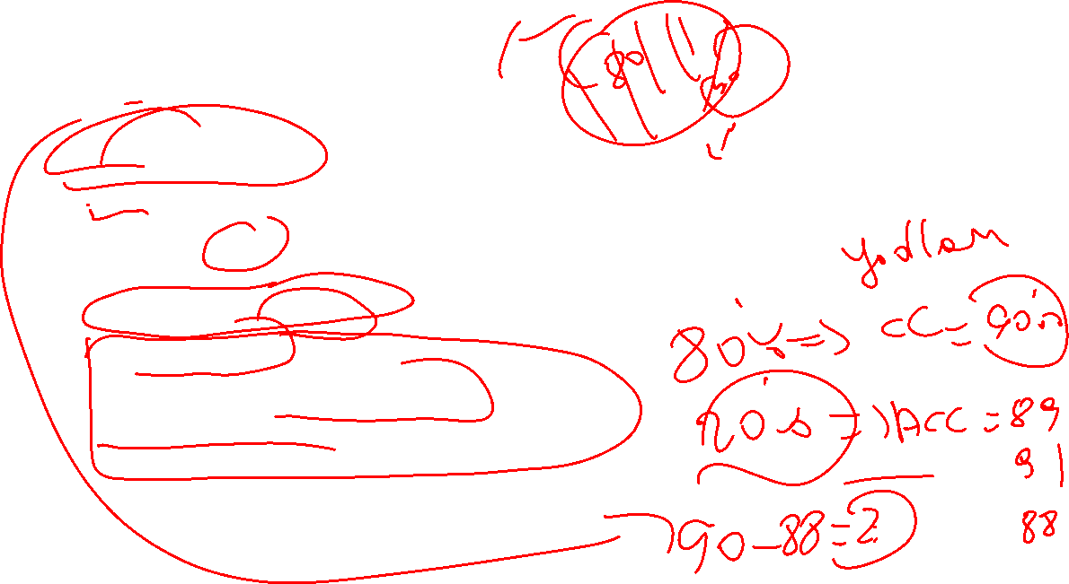




K-Fold cross validation
Cross validation
SML model qanday ko’rilmagan dataset bn ishlashini(yaxshi yoki yomon) baxolash usuli
Turlari:
K-Fold cross validation
Stratified K-Fold Cross Validation
Leave-One-Out Cross Validation (LOOCV)
Leave-P-Out Cross Validation

Slide 7
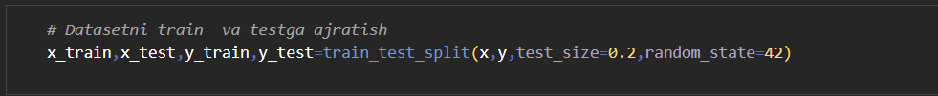



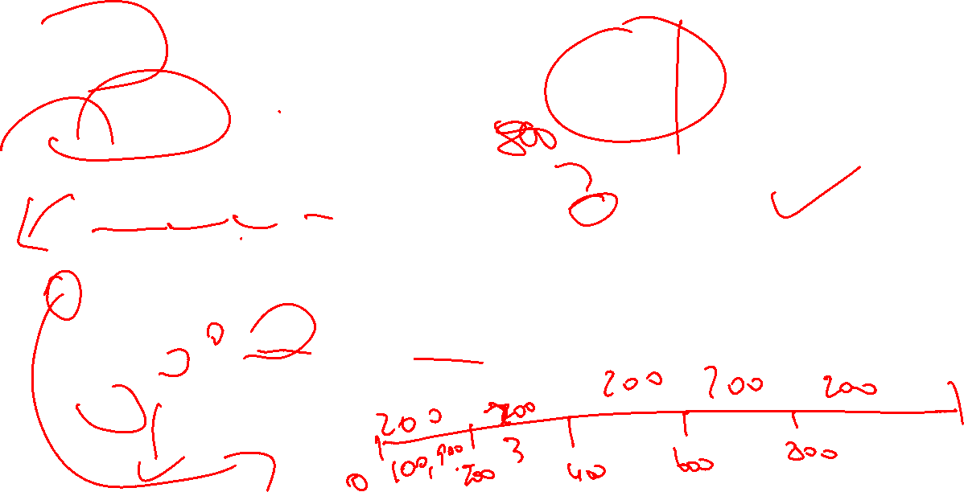
K-Fold cross validation
Single split
K-Fold split
Datasetni k ta teng qismlarga ajrating
Train k-1 folds
Test (qolganini)

Slide 8
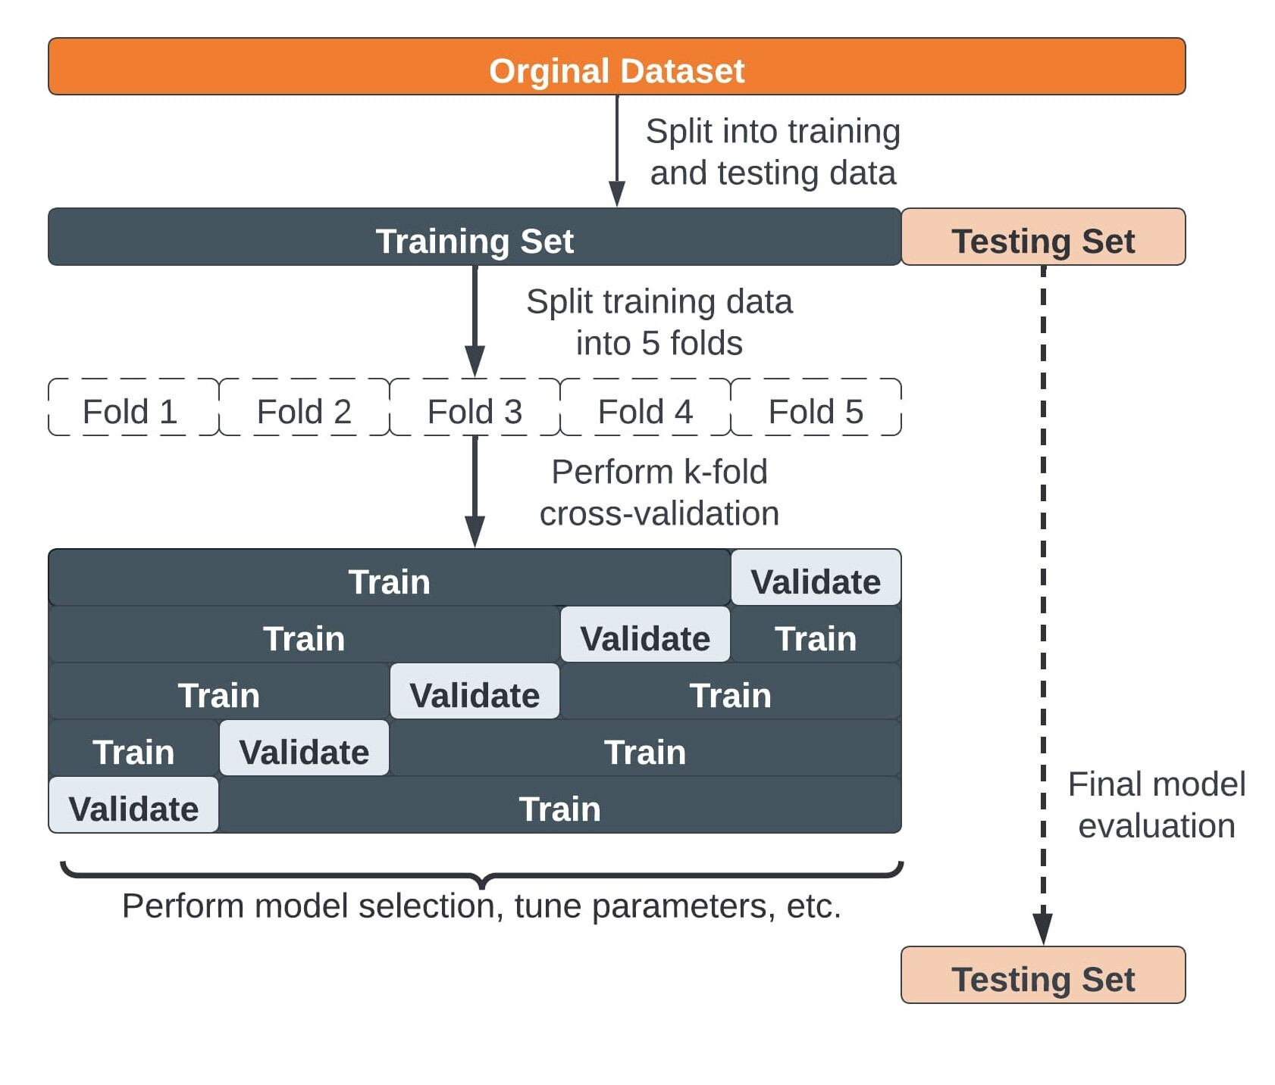






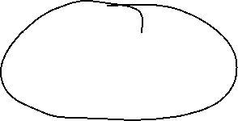


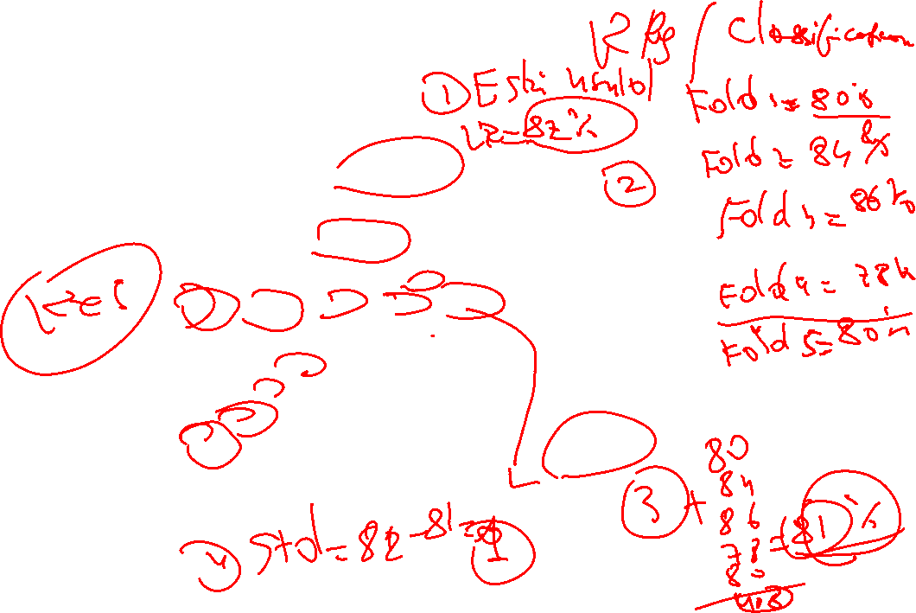




K-Fold cross validation

Slide 9






Vazifa

Slide 10




Vazifa
Data Preprocessingdan 4 ta basic va xar biriga 5 tadan follow-up tuzing
Yangi dataset toping va classification va regressionga alohida alohida k-foldni tekshiring

